Slide 1

TECHNO 8

Slide 2
INDEX
Project Description
Members and Code Contribution
User Roles & Functionalities
System Structure
Implementation Details
Testing Experiences
Risks
Peer Review and Feedback

Slide 3
Project Description
Developed a Question and Answer Website which connects the individual minds through questions.
It includes features as follows:
User creates an account for signup and the same would be stored in the database.
If the user already exists, Login is required.
Successful Login helps user to post their doubts, Questions and even the views that are running in their minds as well to share their knowledge on the present trending topics like Top news, Technologies, Entertainment, Health, Education etc.
User can edit the profile if in case any wrong information is provided during the signup.

Slide 4
Project Description cont..
User can post their creative content which resembles the blog, Upload the images.
Implement Search Engine where the user can search for People and also search the content according to their interest
Adding pagination would divide content into discrete pages, thus presenting content in a limited and digestible manner without making it clumsy.
Using Site Maps to crawl on the browser like Google and Yahoo.
User can update, delete posts and look at his posts history anytime.

Slide 5
Members and Code Contribution
Members | Contribution
DEEPTHI POTHINENI | Backend Developer, Documentation
CHANIKYA DEVARAPALLI | Backend Developer, Testing
SHIRIDI CHAITANYA SANDHYALA | UI Developer, Database
SAISREE GUMMADI | UI Developer, Presentation
KEERTHI CHINTA | UI Developer, Documentation
BINDU JAMMULA | Backend Developer, Testing
VISHWANATH REDDY RAMAYYAGARI | UI Developer, Database
SURVI VIDIT DATTA | Backend Developer, Testing

Slide 6
User Roles & Functionalities
End User
Can create and look at other posts.
Can comment on other’s posts in the community.
Can Delete and Update the posts.
Add Profile and Cover Picture, Can edit Personal Details anytime.
Admin
Authenticate the user.

Slide 7
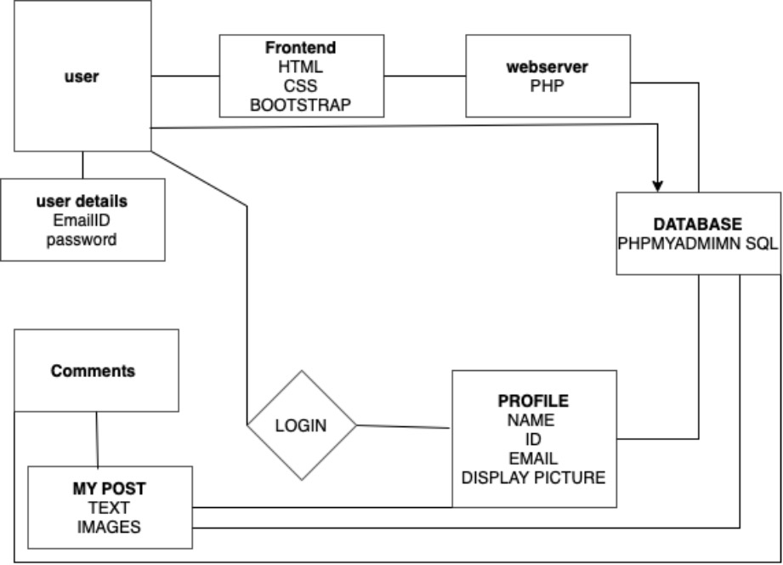
System Structure

Slide 8
Implementation Details
Application Framework : PHP
Front End : HTML, CSS & JavaScript
Backend : MySQL
IDE : PyChamp
Testing : Manual Testing ( Unit Testing)
Source Control : GitHub

Slide 9
Testing Experiences
Unit Testing
All individual system components.
Used Manual Testing for all the components.
System Testing
All possible scenarios (Success and Error Cases that could happen in the application).
Total of 30 Test cases done for System Testing.

Slide 10
Risks
Security Risks:
Since passwords are not encrypted, it poses a Security Risks.
Privacy Settings are not yet developed which may impose in Users discomfort.
Technology Risks:
Lack of Technical Expertise.

Slide 11
Peer Review and Feedback
Feedback given by Tech8 :
We were asked to add Remember Me Capability – Accepted.
Asked to make some cosmetic changes in UI Design – Rejected.
Asked to add Find New People - Can be achieved with Existing Functionality.
Code Inspection Feedback :
Missing line comments – Added wherever required.
Added Error validation Messages.

Slide 12
THANK YOU

